Slide 1
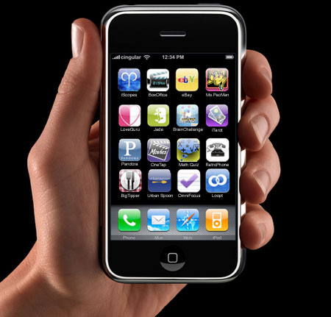


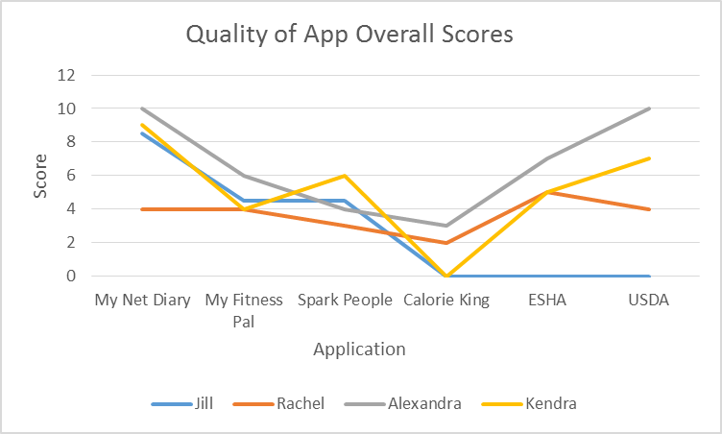
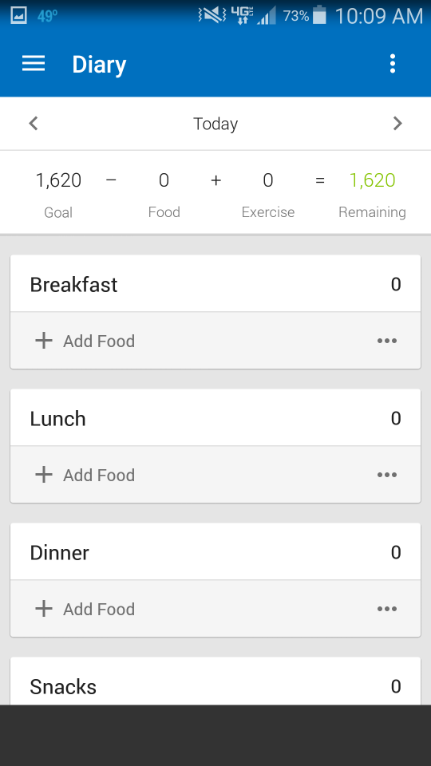
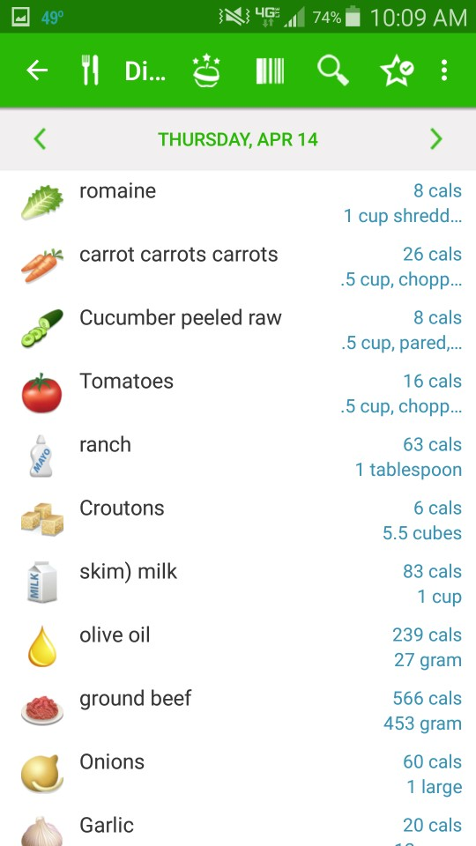
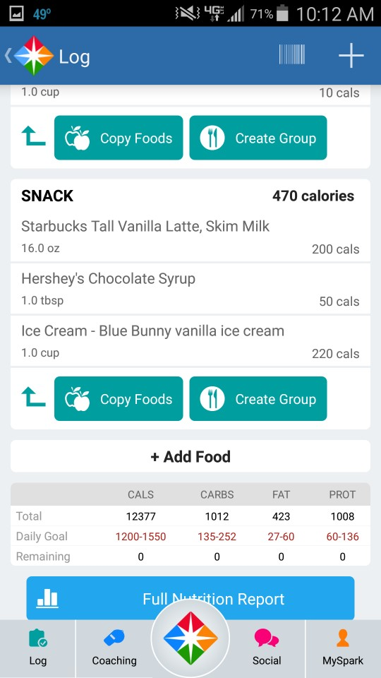
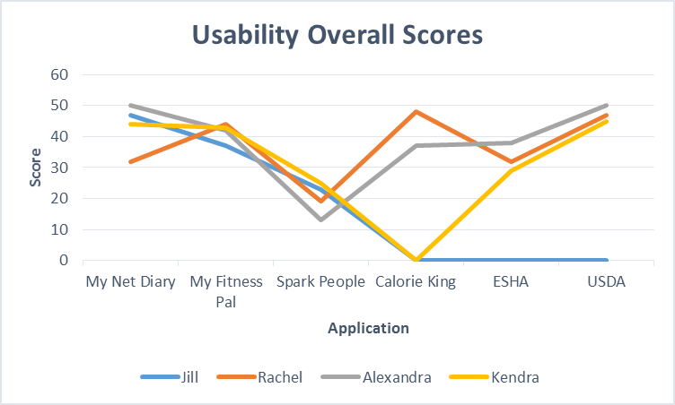
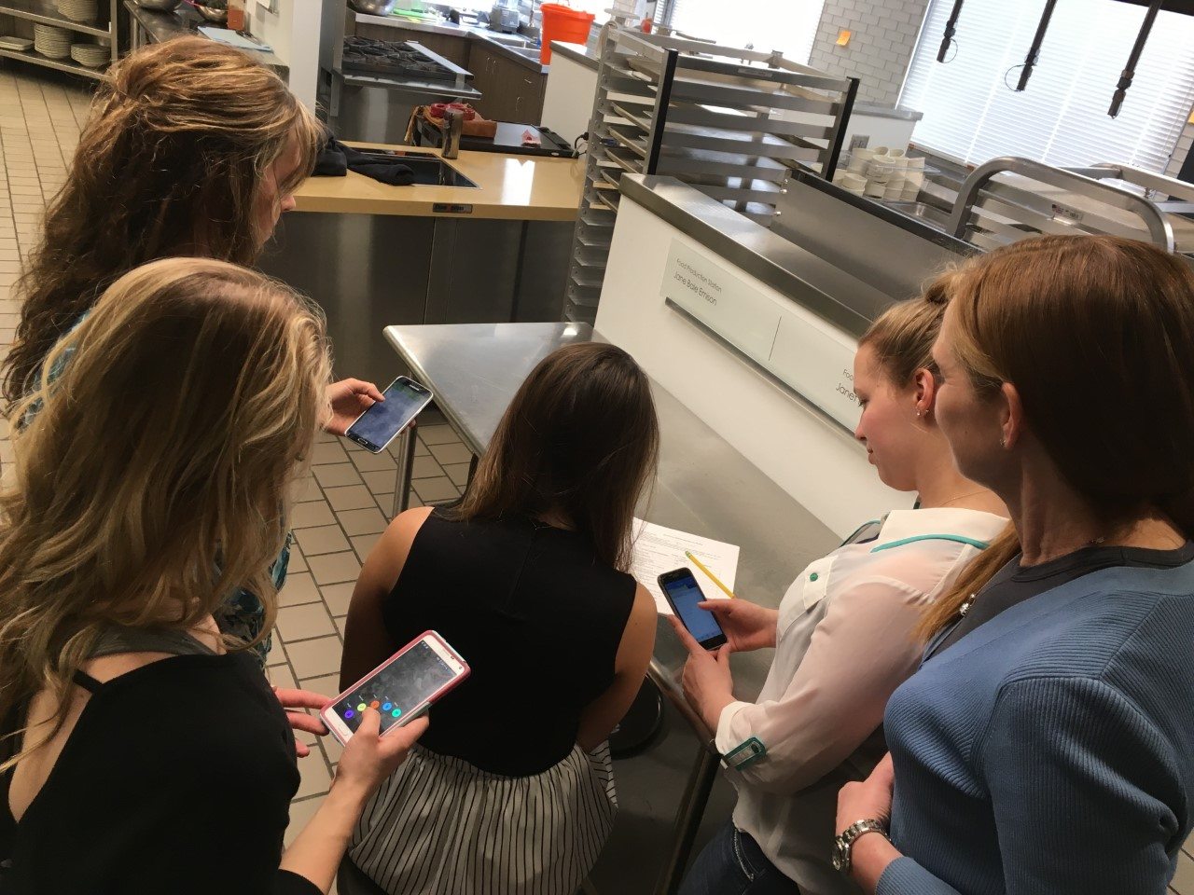
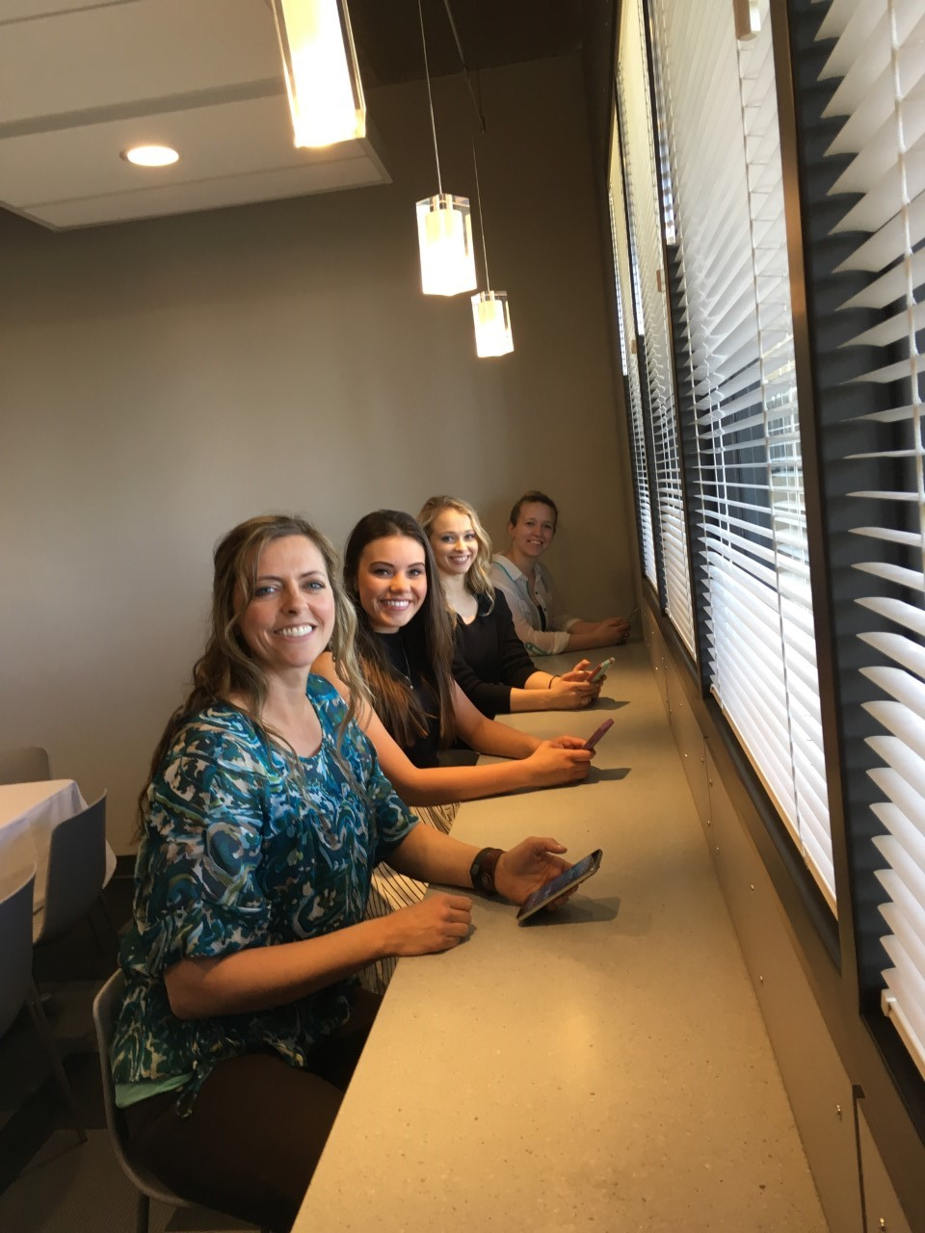
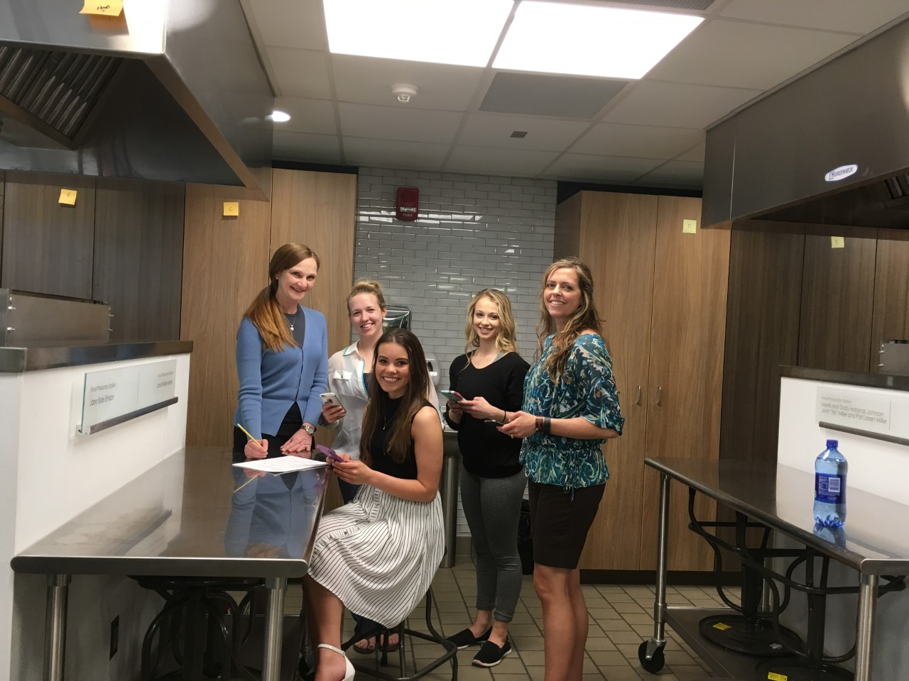
Accuracy of Nutrient Information Provided by Popular Smart Phone Apps & Impact of User Differences
Kendra Vigdal and Alex Sherrard, dietetic students; Rachel Dewey, graduate student; Jill Keith, Ph.D., R.D., L.R.D.; and Sherri Stastny, Ph.D., R.D, C.S.S.D., L.R.D
abstract
Steps
results
Americans consume the majority of daily calories away from home and may rely on smart phone apps to quickly identify nutrition information when making food choices. While the availability of apps providing nutrition information can offer convenience, a recent pilot study revealed up to 40% error in the most popular apps. The objective of this study was to compare four dietary analysis tools with the gold standard for accuracy. Dietary analysis tools included the “gold standard” ESHA program, My Fitness Pal, Spark People Calorie Counter, My Net Diary, and Calorie King. Two standardized recipes were analyzed using all five dietary analysis tools. The research team included two registered dietitians, three graduate/undergraduate dietetic students, and one undergraduate non-dietetic student. All team members evaluated each recipe using all dietary analysis tools. Nutrients of interest, including all those required on the current FDA Nutrition facts label, were compared for significant mean differences using factorial ANOVA. Individual analysis of nutrients was compared for significant differences to evaluate inter-rater reliability. Accuracy of dietary analysis tools is important for consumer and nutrition professional use and recommendation. Significant differences among nutrient analysis tools may negatively contribute to consumer food choices and ability to control diet-related chronic disease.
1 | Find each app and download it to your smartphone. All apps should be free. (A free version of Calorie King is available. We will try to use this one on our first attempts)
2 | Enter 1-day food diary information (including 2 recipes) into all 6 analysis tools (USDA Nutrient Database, ESHA, apps). Start with USDA Nutrient Database then continue in any order. Use the “standard” information of a 30-year old, 126 pound, 5’4”, sedentary female (the reference woman for the Estimated Calorie Needs per day, by Age, Sex, and Physical Activity Level from the 2015-2020 Dietary Guidelines for Americans). i. This step requires you to track your time spent in entering food information into each analysis tool.
3 | Enter nutrient information from each analysis tool (USDA Nutrient Database, ESHA, apps) into the Excel spreadsheet. The Excel doc will have a separate “sheet” for ESHA, USDA Nutrient Database, My Fitness Pal, Spark Calorie Counter, My Net Diary, and Calorie King.
4 | Evaluate each app (4) for Quality and Usability (8 total evaluations).
Objective
The objective of this study is to compare four dietary analysis tools with the gold standard(s) for accuracy, quality, and usability. Dietary analysis tools will include the “gold standard”
(1) ESHA program
(2) USDA Nutrient database
(3) My Fitness Pal
(4) Spark People Calorie Counter
(5) My Net Diary
(6) Calorie King
What we Analyzed
Two standardized recipes as part of a 1-day food diary using all six dietary analysis tools starting with the USDA Nutrient database.
Nutrients of interest, including all those required on the current FDA Nutrition facts label, will be compared for significant mean differences using factorial ANOVA. Individual analysis of nutrients will be compared for significant differences to evaluate inter-rater reliability. Therefore, careful entry is important.
conclusions
In conclusion, the two gold standards used (ESHA and USDA database) were both closely and highly ranked. In comparison to these two the next best application evaluated was My Net Diary. This was the highest phone application ranked by all of our team members on usability and reliability. This was then followed by My Fitness Pal and Calorie King which also ranked fairly well in usability but noticed a few more errors in the application and process. Spark People was the application that ranked the lowest on usability and features from all of our team members. This study revealed many interesting conclusions on the usability and reliability of these popular nutrition applications. The knowledge on this can help users utilize these applications/ the best applications in the future to achieve their desired results.

